Slide 1



Dynamic Login And Landing Page - Android App
Welcome to introductory presentation on the dynamic login and landing page Android app. Get ready to learn about its features, architecture, challenges, and more!
NAME :- KOMAL BHARTI & JASHAN VIJ
ROLL NUMBER :- 2110992574 & 2110992564
CLASS/SEC :- BCA-5A

Slide 2
Abstract
Our Android Development Project is a focused initiative leveraging Kotlin and Jetpack Compose for efficient and expressive mobile app creation. Utilizing declarative UI principles, we ensure a concise and engaging user interface. With Kotlin's robust features like null safety and coroutines, our project prioritizes code efficiency and reliability. The component-based architecture enhances code reusability, and seamless integration with Android Studio streamlines the development process. This presentation highlights the advantages of our modern approach to Android app development, emphasizing simplicity, responsiveness, and scalability.

Slide 3

Introduction and Background
Problem Statement
Explore the need for a dynamic login and landing page in Android app development, addressing user engagement and personalization.
Target Audience
Identify the user segments that benefit most from a dynamic login and landing page, such as e-commerce, social media, and online services.
Benefits
Highlight the advantages of an interactive and personalized login and landing experience, including increased user satisfaction and retention.

Slide 4
Language used for the Android Development
Language used:- Kotlin
Concise Syntax:
Kotlin offers a concise and expressive syntax, reducing boilerplate code and enhancing readability.
Coroutines for Asynchronous Programming:
Kotlin's native support for coroutines simplifies asynchronous programming, offering a more readable and efficient way to handle concurrency.
Smart Casts and Type Inference :
Kotlin's smart casts and type inference capabilities reduce the need for explicit type declarations, resulting in more concise and maintainable code.

Slide 5
Android UI Toolkit used:- Jetpack Compose
Jetpack Compose [Ui Toolkit]
Jetpack Compose is a modern Android UI toolkit developed by Google for
building native Android applications. It is part of the larger Android Jetpack
set of libraries and tools, designed to simplify and accelerate Android app
development.
Jetpack Compose allows developers to describe the UI in a declarative manner, meaning you specify what the UI should look like based on the current state, and the framework takes care of updating the UI accordingly. This is in contrast to the traditional imperative approach where you specify how to update the UI.
Jetpack Compose is integrated with Android Studio, providing features such as code completion, navigation, and a real-time preview of the UI while coding.

Slide 6
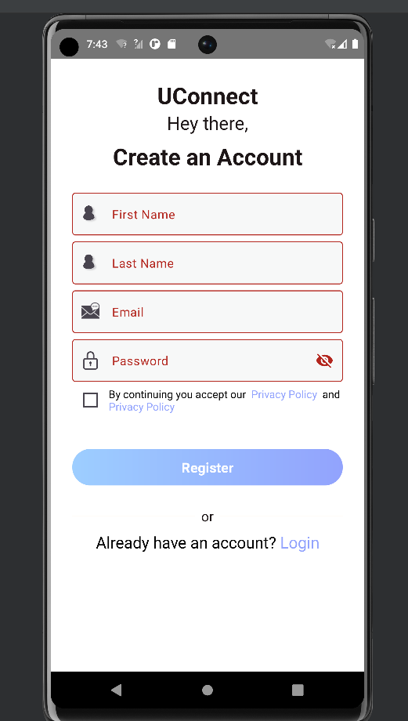
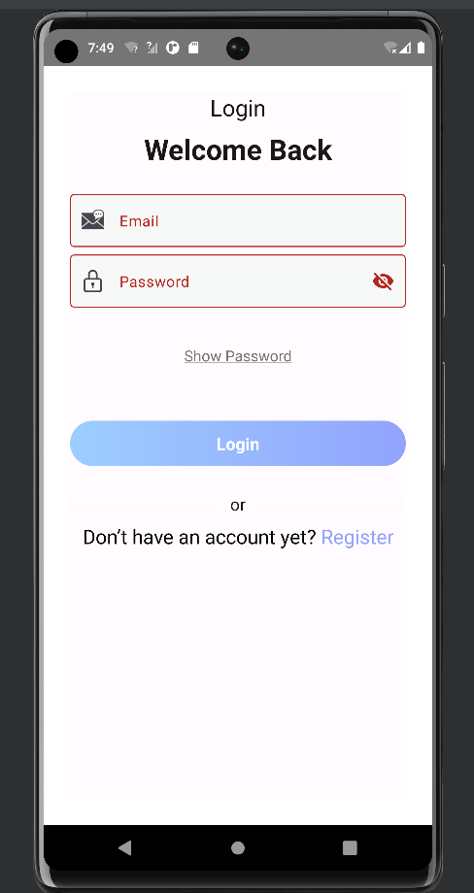
Demo of the Android App

Slide 7
Technical Details and Architecture
Frontend Technologies
Backend Technologies
UI Toolkit
Jetpack Compose
Kotlin
Java
XML
RESTful APIs
Android Studio
Firebase

Slide 8

Challenges Faced During Development
1
Responsive Layout
Explain the challenges encountered while ensuring the login and landing page adapt to different screen sizes and orientations.
Data Synchronization
2
Discuss the complexities of synchronizing user preferences and login data across multiple devices and platforms.
3
Security Measures
Highlight the security considerations and measures taken to protect user information and prevent unauthorized access.

Slide 9

Concluding Remarks and Q&A Session
NAME :- Komal Bharti
& Jashan Vij
ROLL:- 2110992574 & 2110992564
BATCH:- BCA-2021
SEC:- 5A
In conclusion, the dynamic login and landing page Android app offers a personalized and engaging user experience. Feel free to ask any questions during the Q&A session! Email:- kbhati2574.ca21@chitkara.edu.in

